Slide 1

COGNITIVE COMPUTING

Slide 2
WHAT IS COGNITION..?

Slide 3

COGNITION
Cognition is "the mental action or process of acquiring knowledge and understanding through thought,experience,and the senses”.
Cognitive processes use existing knowledge and generate new knowledge.
The concept of cognition is closely concepts such as mind and intelligence.
related
to abstract
Technologies – natural language processing, machine learning

Slide 4
In order to achieve this new level of computing, cognitive systems must be
Adaptive
Interactive
Iterative and stateful
Contextual

Slide 5
COGNITIVE COMPUTING
Mimicking the function of a human brain and handling human kind of problems.
Combination of technologies to understand human interaction and provide answers.
Cognitive computing systems use machine learning algorithms.
Such systems continually acquire knowledge from the data.

Slide 6

IBM WATSON
Super computer developed by IBM Research
Named for IBM’s founder –Thomas J Watson
Research team led by Principal Investigator Dr. David Ferrucci.
Programmed by 25 IBM scientists
Not connected to Internet

Slide 7
WATSON
Watson is an artificial intelligent computer system
Capable of answering questions posed in natural languages
Able to build knowledge and learn ,understand language and interact more naturally with human beings
natural
More than hundred techniques are used to analyse natural language

Slide 8
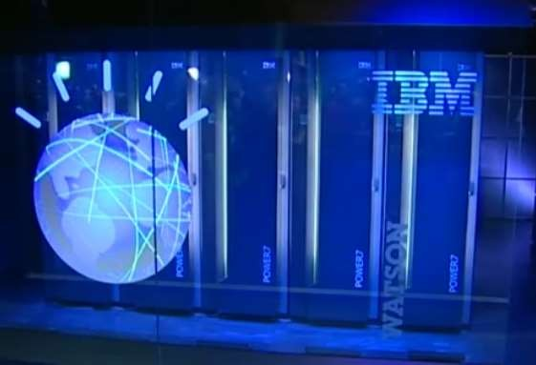
TECHNOLOGY
Question answering technology
Deep understanding of human language
Software-DeepQA
Runs on cluster of power 750 computers
10 racks holding 90 servers
2880 3.55GHz power processor cores
16 TB memory
Hold approximately one million books

Slide 9
GOAL OF WATSON
According to IBM, "The goal is to have computers start to
interact in natural human terms across a range of applications and
processes, understanding the questions that humans ask and providing answers that humans can understand and justify.“
The goal of cognitive computing is to create automated IT systems that are capable of solving problems without requiring human assistance.

Slide 10
APPLICATIONS
HEALTHCARE
The Data Explosion-Medical data are expected to double every 73 days by 2020.
The Great Unknown-80% of health data are invisible to current systems because they are unstructured. Watson Health can see them.
A Quick Study-Watson can read 40 million documents in 15 seconds.

Slide 11
Cognitive Computing is making agriculture more productive.
Cognitive Computing is making cars smarter.
Cognitive Computing is making our homes and offices more secure, as well as our borders.

